Slide 1

What do journalists really want from NLP researchers?
How to help build trust in media and democracy by helping journalists understand big data
First Workshop on NLP for Internet Freedom
20 August 2018

Slide 2
NANCY WATZMAN
Director of Strategic Initiatives, Dot Connector Studio
Current clients: Knight Foundation – Knight Commission on Trust, Media and Democracy; Democracy Fund
Past: Internet Archive, Sunlight Foundation, Center for Responsive Politics, Center for Public Integrity, and more...

Slide 3
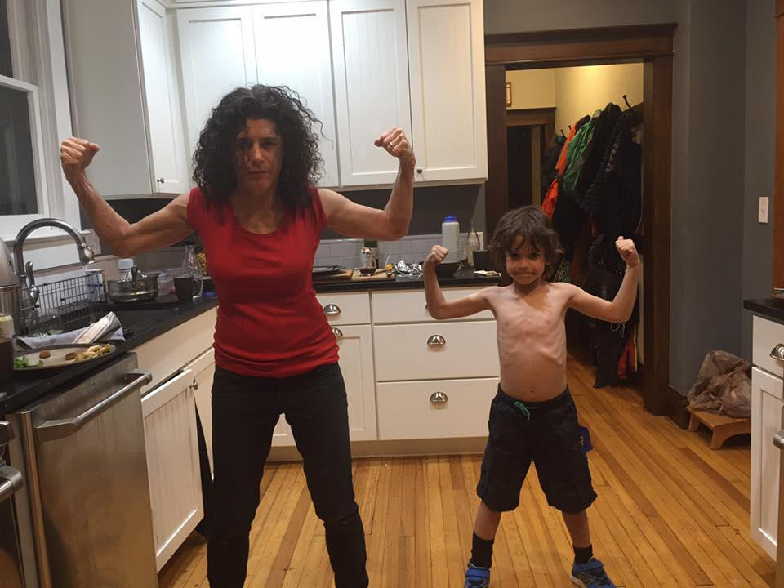

Slide 4
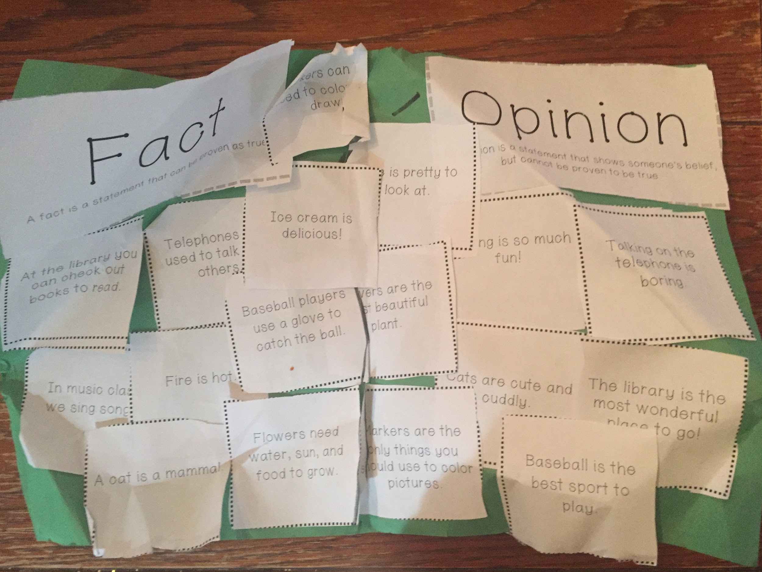

Slide 5
ClaimBuster.
0.39 Cats are cute and cuddly.
0.35 Markers are the only things you should use to color pictures.
0.32 In music class we sing songs.
0.27 Talking on the telephone is boring.
0.27 Baseball players use a glove to catch the ball.
0.24 Flowers are the most beautiful plant.
0.23 Fire is hot.
0.21 Singing is so much fun.
0.21 Telephones are used to talk to others.
0.20 Markers can be used to color and draw.
0.20 Ice cream is delicious.
0.19 Baseball is the best sport to play.
0.19 The library is the most wonderful place to go.
0.19 A cat is a mammal.
0.15 At the library you can check out books to read.
0.13 Flowers need water, sun and food to grow.

Slide 6

HOW DID WE GET HERE?

Slide 7
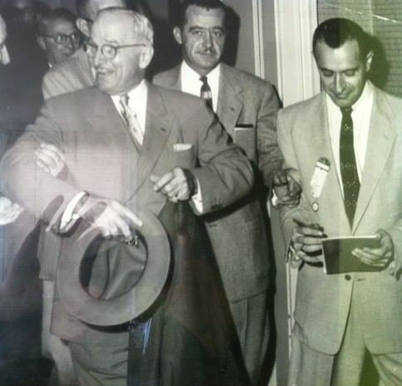
The good old days

Slide 8
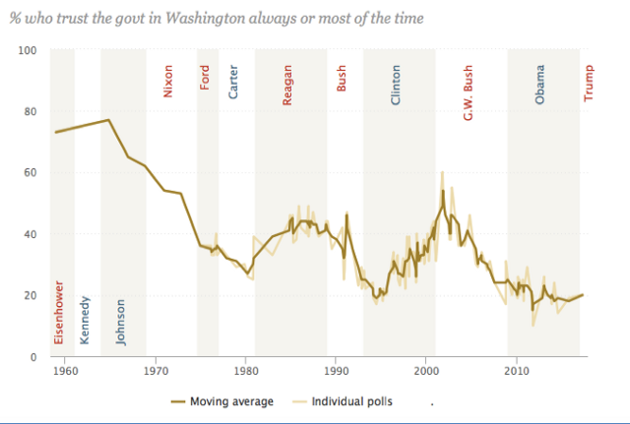
Americans’ Trust in Government: 1958–2017
Source: Pew Research Center

Slide 9
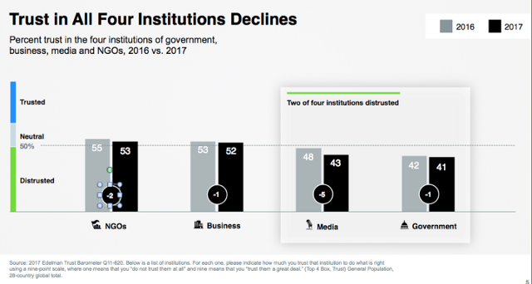

Slide 10
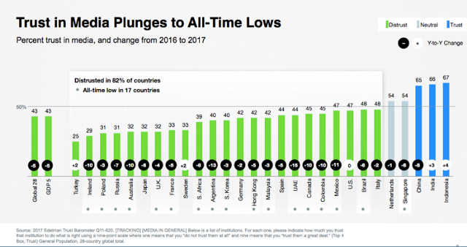
Source: 2017 Edelman Trust Barometer, Ben Boyd presentation, NYC, October 12, 2017

Slide 11

Knight Commission on Trust, Media
and Democracy
How to comment: https://kf.org/Comment

Slide 12
Chapter 2 draft findings: What Happened to Trust?
Large-scale global economic, social and political “shocks” have shaken people’s faith in a variety of democratic institutions including government.
Poor performance in effectively safeguarding the public interest and delivering expected services erodes confidence in government.
Growing political polarization contributes to a diminished willingness to support a shared political enterprise that necessarily operates through compromise.
An increase in economic inequality and a declining belief in fairness of government weaken trust in the institution.
Declining economic mobility diminishes faith in government as a mechanism to provide opportunities for all.

Slide 13
Chapter 3 draft findings: The New Media Landscape
Exponential advancements in digital technology, coupled with explosive growth in broadband Internet and ubiquitous mobile access, have dramatically shifted how news and information are produced and consumed.
The drastic decline in advertising revenues for print newspapers over the past two decades has challenged the viability of business models for news.
Social media platforms connect users across the world, but have raised concerns about privacy, manipulation and foreign interference.
The “public square” has become a 24-hour, continuously connected mobile experience supported by social networks, broadcast, and cable television.
Explanations for the decline in the public’s trust of media include the proliferation of news sources, the blurring between news and opinion, media disintermediation and the spread of misinformation and disinformation.

Slide 14
Chapter 3 draft findings: The New Media Landscape (Cont’d)
Navigating the new media environment and separating truth from non-truth will continue to become more challenging as emerging technologies, such as virtual reality, bots and deepfakes, become more sophisticated.
A confluence of sociological and economic circumstances, along with technological advancements, have created a “perfect storm” that is destabilizing citizen trust in media and other democratic institutions more generally.

Slide 15

II. How can NLP researchers help?

Slide 16
Many philanthropic efforts underway. A few:
Knight Foundation Trust, Media and Democracy Initiative: https://kng.ht/2M4OFPr
Hewlett Foundation: Research roadmap: http://bit.ly/2MtVg2; Facebook initiative: http://bit.ly/2vOUVAq
Rita Allen Foundation: Behavioral approach: http://bit.ly/2OkwQt0
News Integrity Initiative: http://bit.ly/2MqRVBk
Disinformation projects and funders database: http://bit.ly/2vHg3sg
Must reading: Witness, “Deep fakes and synthetic media: What should we fear? What can we do?”

Slide 17
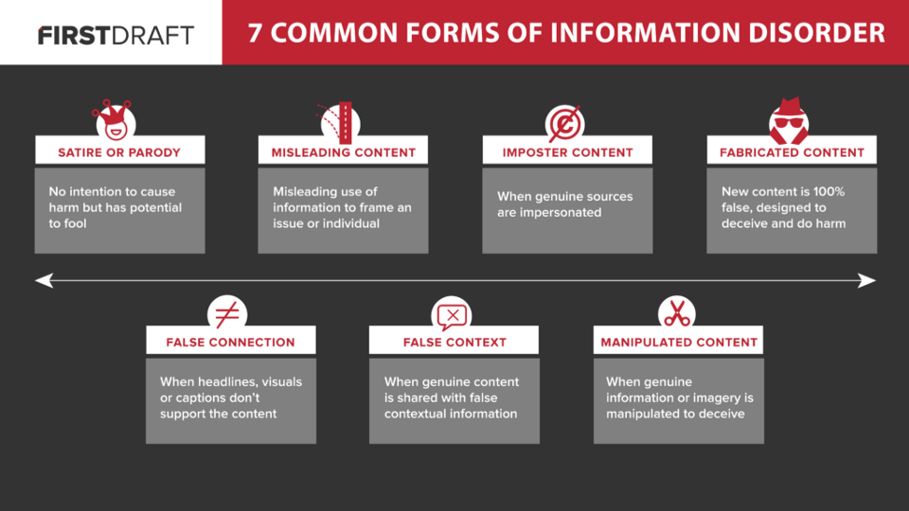
https://medium.com/1st-draft

Slide 18
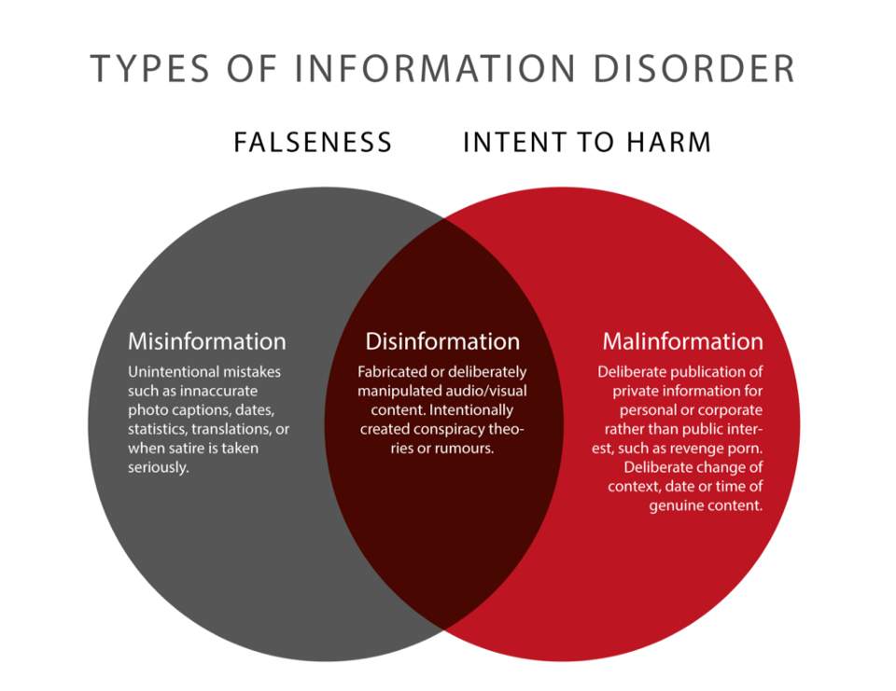
https://medium.com/1st-draft

Slide 19

Source: Peter Morgan, Creative Commons.

Slide 20
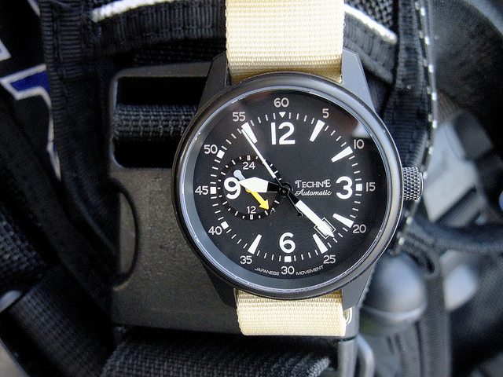

Slide 21
Jonathan Stray, Columbia University
“Making Artificial Intelligence Work for Investigative Journalism”
“What do Journalists do with Documents? Field Notes for Natural Language Processing Researchers”
https://journalism.columbia.edu/faculty/jonathan-stray

Slide 22
From Jonathan Stray, “Making Artificial Intelligence Work for Investigative Journalism”
Document classification
Language analysis
Monitoring for breaking news
Lead generation

Slide 23
“The Echo Chamber,” Reuters, Biskupic, Roberts, and Shiffman 2014: https://www.reuters.com/investigates/special-report/scotus/
Reuters reporters showed how a small group of elite lawyers have argued most of the cases before the U.S. Supreme Court (Biskupic, Roberts, and Shiffman 2014). The reporters also broke down the number of accepted cases by type, for example whether filed by a business, individual, or government agency. They accomplished this mostly by hiring 20 freelancers to read 10,300 petitions over a period of three months, but were able to gain some additional information through LDA topic modeling (Stray 2016a).

Slide 24
“DHHS downplayed food stamp issues," (Dukes 2013) https://www.wral.com/records-dhhs-downplayed-food-stamp-glitches/13173174/
...a WRAL reporter used Overview (M. Brehmer et al. 2014) to automatically cluster 4,500 pages of state government emails obtained through a Freedom of Information Act request. One large cluster corresponded to messages posted to an inter-county government email list. The reporter manually read this cluster and found messages showing the government officials knew that a web browser compatibility problem was causing delays, ultimately affecting 70,000 people. (Dukes 2014)

Slide 25
Washington Post story: “Whistleblowers say USAID’s IG removed critical details from public reports,” (Higham and Rich 2014) https://wapo.st/2vTCStd
For the Washington Post story “Whistleblowers say USAID’s IG removed critical details from public reports,”reporters compared 12 draft reports with their final versions. Using sentiment analysis, they found that more than 400 negative references were removed before publication (Stray 2016a).

Slide 26

III. Case study: Duke Reporters’ Lab Tech & Check

Slide 27
Duke Tech & Check – matching claims with published fact-checks
Take sentences from
Cable news shows (CNN, Fox, etc.)
YouTube videos and livestreams
Microphone audio
Find related factchecks from a Share the Facts database of previously fact-checked claims
This reduces to the well-studied natural language processing (NLP) problems of identifying paraphrases and entailments
Current algorithm identifies words with similar meaning between the spoken sentence and sentence from the database

Slide 28
Bob the Algorithm
Written by Duke students based on research on natural language processing (“Bob” is the algorithm’s code name)
Identifies words with similar meaning in the spoken sentence and sentence from the database
Challenge: the common NLP problem of identifying claims that are paraphrases of claims in the database, or ones that logically follow from a claim in the database (entailment).

Slide 29
Paraphrase matching
We found the algorithm is good at matching semantics
Last
year
we
lost
500
billion
in
trade
with
China
In 2017
we
lost
half a trillion
in
trade
with
China

Slide 30
Paraphrase matching
The algorithm performs well even with differing sentence structures
Last
year
we
lost
500
billion
in
trade
with
China
Trade
deficit
with
China
was
half
a
trillion
in
2017

Slide 31
Paraphrase matching difficulties
The algorithm is most frequently fooled by sentences which share many words but differ in words critical to overall meaning
Last
year
we
lost
500
billion
in
trade
with
China
We’ve
lost
500
factories
since
2017
due
to
trade
with
China

Slide 32
Entailment
The algorithm is also frequently fooled when the database sentence contains the right information as well as additional information irrelevant to the spoken sentence (in NLP this is referred to as entailment)
Last
year
we
lost
500
billion
in
trade
with
China
Trade
deficit
with
China
was
one
trillion
in
2016
and
half
that
in
2017

Slide 33
Present state
Current algorithm is ~93% accurate in determining if two sentences are paraphrases of each other
Current algorithm is only ~64% accurate in determining if one sentence implies the other (entailment)

Slide 34
Next steps
Shift focus from pure paraphrase matching to paraphrase and entailment matching
Use a database of over 433k sentence pairs called the Multi-Genre Natural Language Inference Corpus to train our model
Ideally this will increase our accuracy on difficult statements without decreasing accuracy on simple paraphrases

Slide 35

IV. Case study: TV News Archive

Slide 36
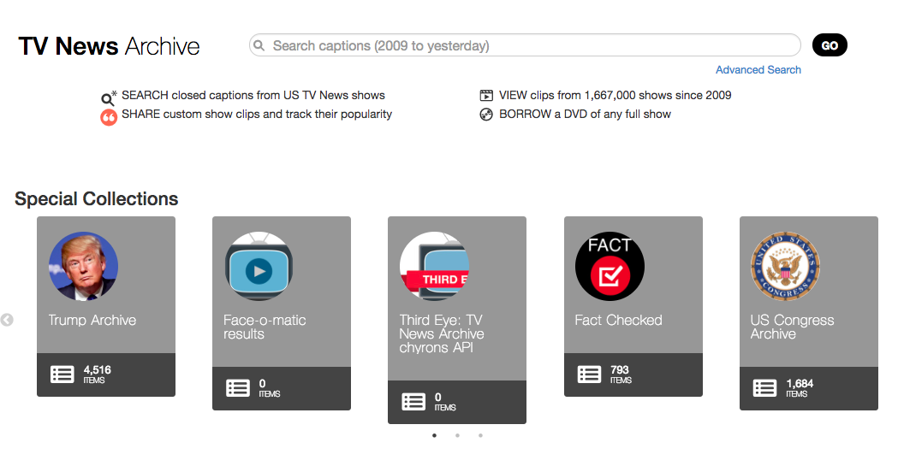

Slide 37
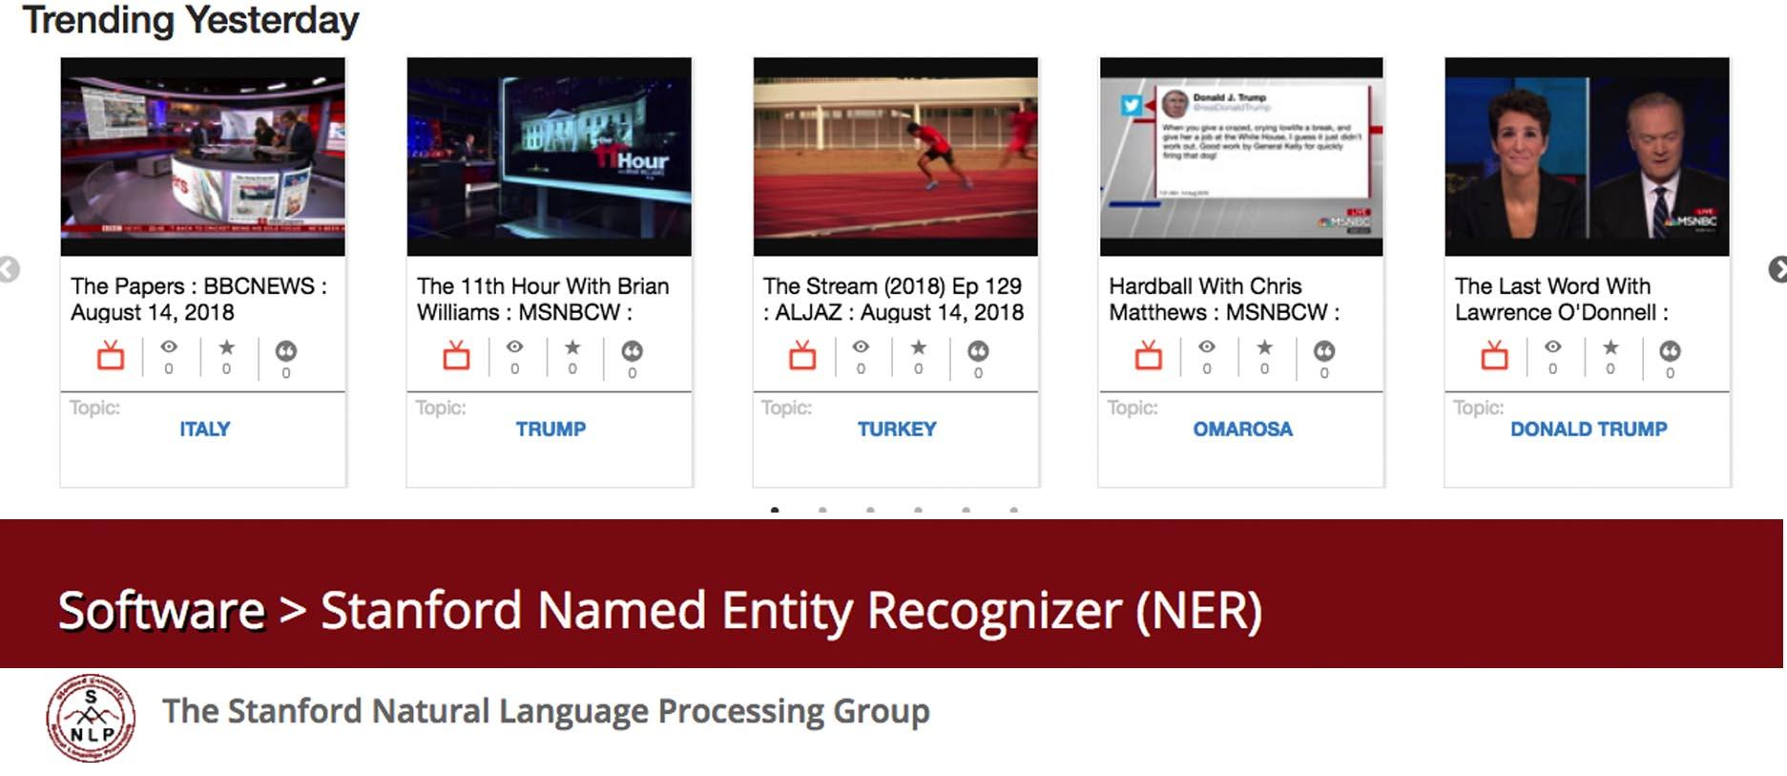

Slide 38
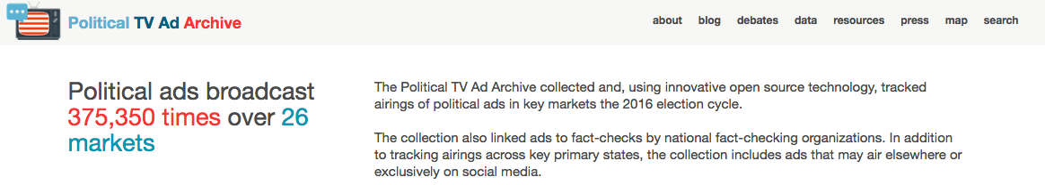
2016 political ads: politicaladarchive.org

Slide 39
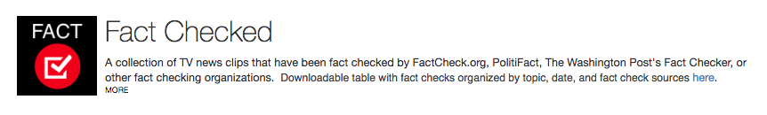
https://archive.org/details/factchecked
Notes:
This collection of fact-checked TV news clips was done manually.

Slide 40

https://archive.org/services/third-eye.php
Notes:
The filtered/non-raw version -- is mostly doing a random set of things to try to find the "best OCR" for the entire minute, etc. (using some `simhash` techniques to identify "similar" (or approximately similar) OCR-ed output in a given minute, etc.

Slide 41
Opened Captions
https://github.com/slifty/opened-captions Dan Schultz, Bad Idea Factory
Notes:
Opened Captions servers can pull a CC stream over a serial port, or (more likely) they will connect to an existing Opened Captions server and pull the stream from there. What that means in de-jargon is that anybody can set up a server that does exactly what mine is doing, even if they don’t have access to hardware, software, or a live TV stream.

Slide 42
V. Conclusion
There’s a lot to do.
We need more collaborations between NLP experts and journalists.
Let’s get to work.
Slides available here: http://bit.ly/2Mvq0nn

Slide 43
Contact me:
Nancy Watzman
@nwatzman
nancy@dotconnectorstudio.com

